Slide 1
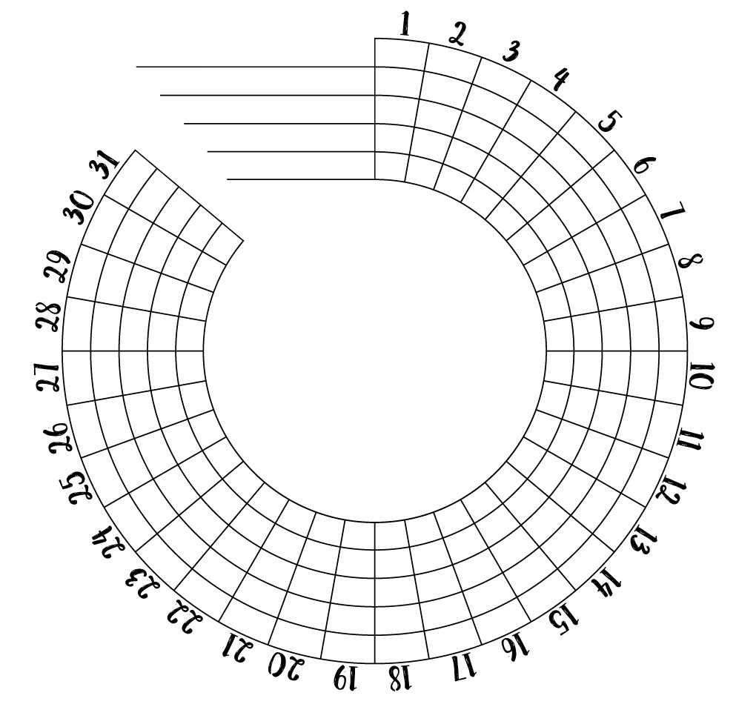
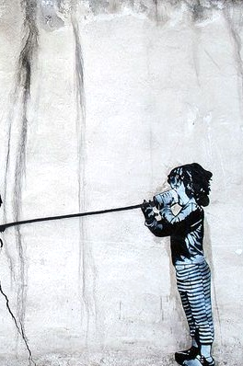
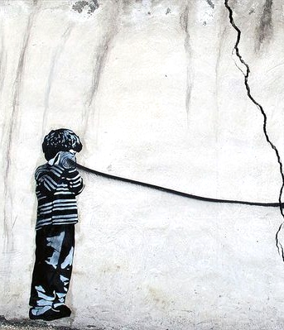
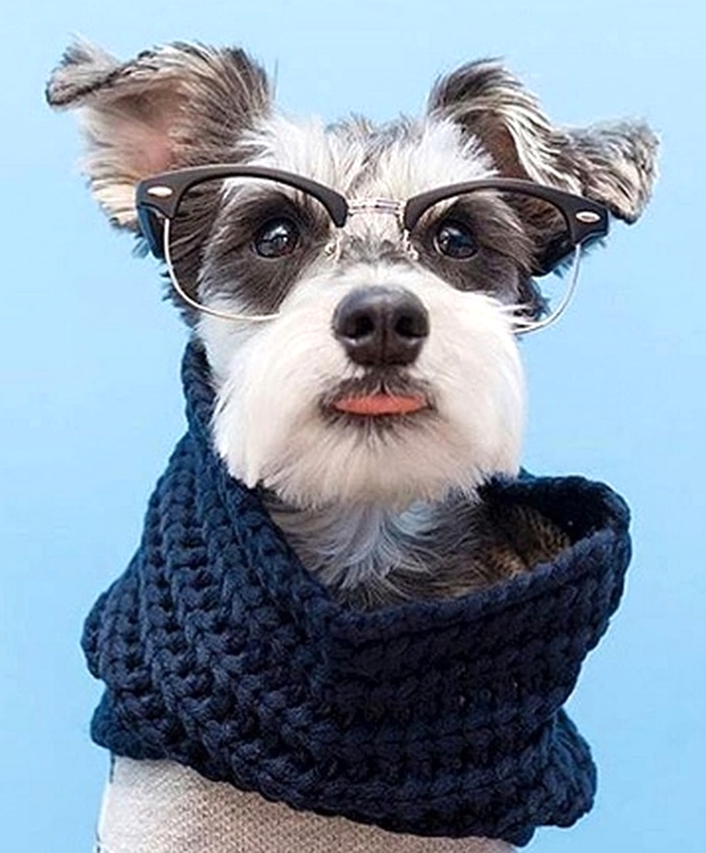
April 2022
April 2022
Sunday Monday Tuesday Wednesday Thursday Friday Saturday
Sunday Monday Tuesday Wednesday Thursday Friday Saturday
Think
Positive,
be
Courageous,
& take another step toward Wellness.
Inhale for 3
Hold for 3
Exhale for 3
1
2
One thing that makes me Resilient…
7
Last 10
minutes of lunch, time for a
Mini Meditation. Let your thoughts come and go.
I did it!
With all the advancements in communication…
Today I am Thankful for…
8
Recovery is about Progression not
perfection.
Breathe, you got this!
6
3
4
5
9
Let’s make sure we are connecting with those who need it most.
What is the best thing you bring to a Friendship?
Hydration check
Let’s try
to Stretch
in-between
tasks and meetings today.
14
13
Time to look at Wellness with a different lens!
Inhale, Hold,
& Exhale. Now, three more deep
breaths together Releasing tension & stress.
11
I did it!
I will try again tomorrow
10
12
15
16
19
Eye Wellness
Every small gesture to help the environment counts.
Start the
week by Powering Down:
20 30 45
minutes early before bed.
What stress level am I at, and what can I
do about it?
Three
ways to Simplify my daily routine…
17
What is a Nutritious Snack I can have today?
Meditate
Plan
For every 20
minutes
of screen time
20
How do I make the-
1.
Unplug
Low
High
2.
Look 20 feet away
for 20 seconds.
21
We’re are all in this together.
Exercise
Moderate
3.
18
Allocate
some time today
for self-care and Enjoy your own company.
I did it!
22
Read
23
29
Connect
Draw
the most Dreamlike place on earth.
Take a look at the Positive things surrounding you!
People will come and go in life, but the person in the mirror will be
there forever:
Be Kind
to yourself!
28
30
Sleep
Reflecting on the month, where am I at on my wellness journey?
What are my next steps?
most of my
weekend?
Write
Create
Embellish
24
25
26
27
Your Office of Wellness, 24 Hour and Emergency Services Division

